Slide 2
Part III Trading Relative Strength In Real Time

Slide 3
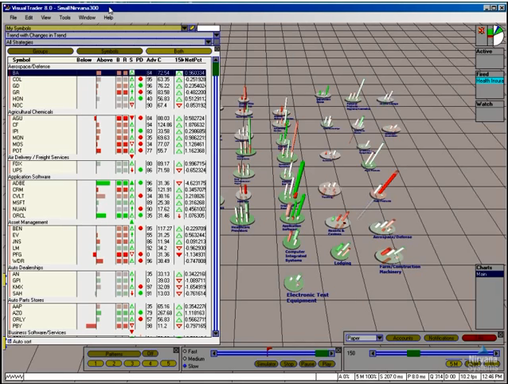
Trading Relative Strength in Real Time
Agenda
Why VisualTrader?
Assets for Harnessing the Power
Trading in Real Time
Using OmniTrader
Practicing in the VT Simulator

Slide 4
Why VisualTrader

Slide 5
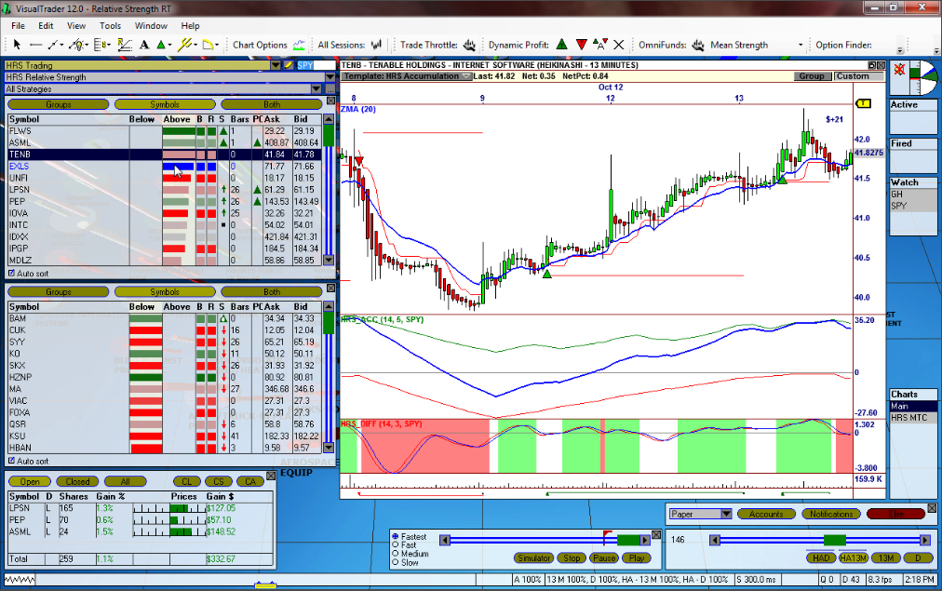
VisualTrader’s Unique Features
Transform*
Leading Indicator
Chart Alerts
Portfolio View
Simulator
* Transform: Length = Accumulated Relative Strength; Color = Change in Relative Strength

Slide 6
Assets for Harnessing the Power of Relative Strength

Slide 7
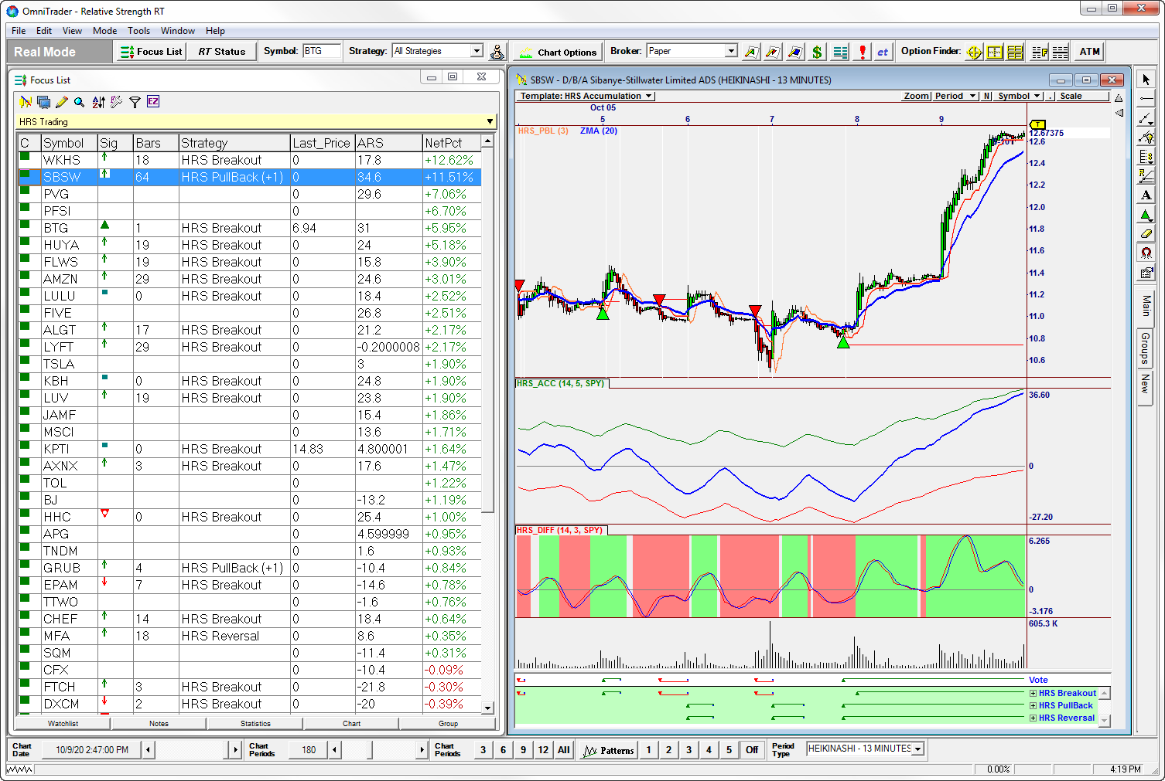
The 3 HPRS Assets
OmniScan * HRS Trading
Chart Template HRS Accumulation
Strategies HRS Reversal HRS Breakout HRS Pullback
* We use the HRS Trading OmniScan because it shows both Strong and Weak Candidates in one list.

Slide 8
Harnessing the Power of Relative Strength in Real Time

Slide 9
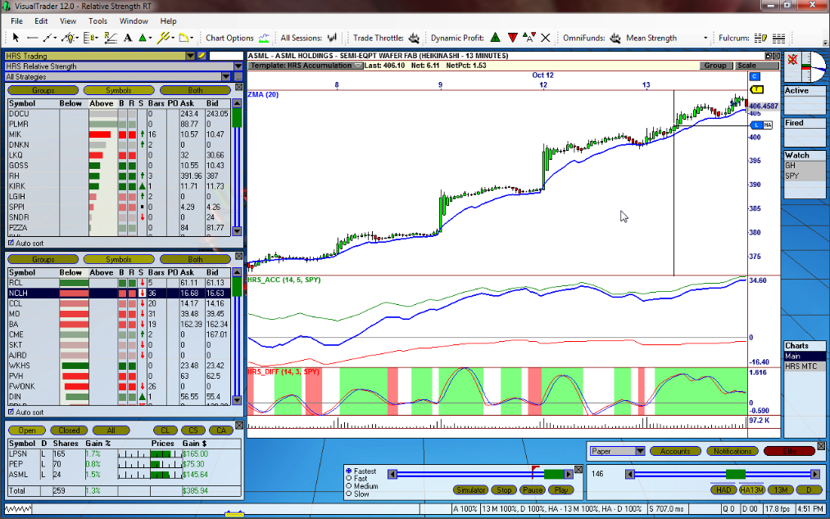
Basic HPRS Concepts
Best Long Prospects
Above 20p ZMA
Best Short Prospects
High ACC Values

Slide 10
Using OmniTrader RT

Slide 11
OmniTrader Setup for Real Time
OmniTrader is set up basically the same as VisualTrader.
Use the HRS Trading OmniScan *
Use an OmniScript Column for the HRS_ACC indicator and Sort on that.
HRS Accumulation Chart Template
* The HRS Trading OmniScan generates both Strong and Weak Candidates in the same list using + and – values.

Slide 12
The VisualTrader Simulator

Slide 13
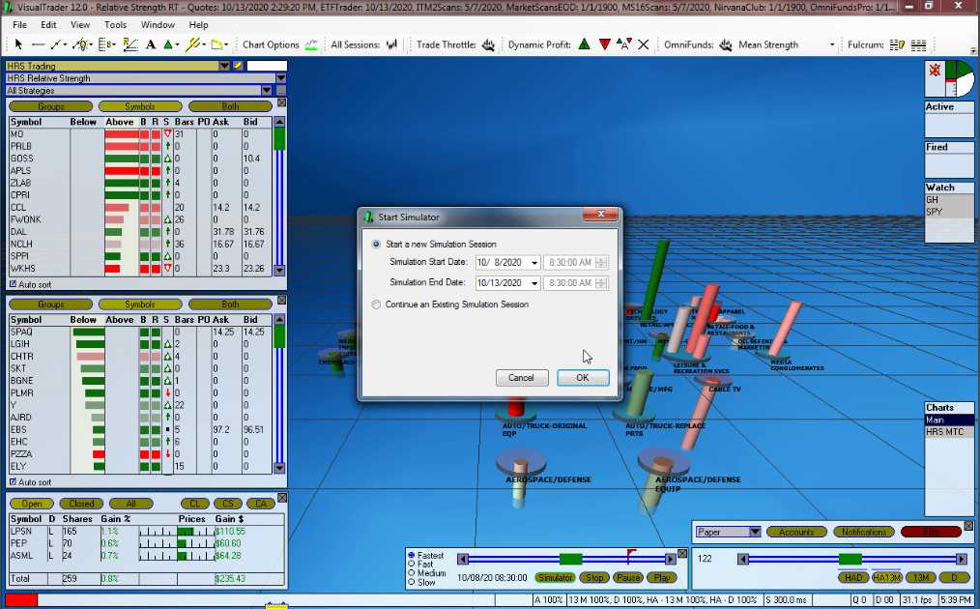
The VisualTrader Simulator
The VisualTrader Simulator is quickly launched by setting a Start and End Date/Time. All assets of the software can be used as time is advanced.

Slide 14
Summary

Slide 15
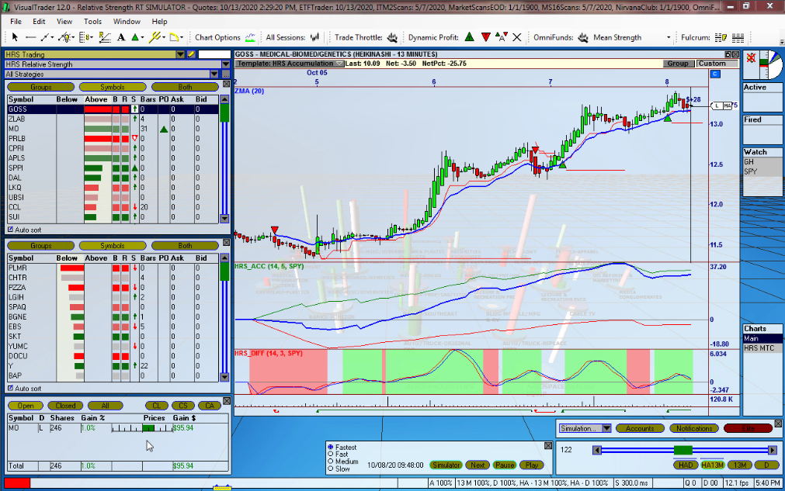
HPRS in Real Time: Process Summary
Harness the Power in Real Time:
Use an HRS_ACC sort to bring the strongest candidates to the top.
Look for pull-backs to the 20p ZMA
Place Trades in the Direction of the Market.
Exit when Profit Targets are reached OR Trade Plan Stops are hit.
Consider early exits if Market Direction changes.
Practice in the Simulator.

